Slide 1

Design and Implementation (in Verilog) of Pong Game
Vladimir Vakhter
ECE Department, WPI
December 5, 2019
Notes:
15-20min
Demo/video of the implementation (1-2 min)

Slide 2
Outline
Purpose.
Hierarchy of Modules.
Block Diagram.
IP Cores.
Custom Hardware Modules.
FPGA resource usage.

Slide 3
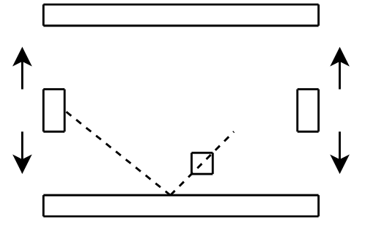
Purpose
Design the Pong game in Verilog:
the 2-player mode.

Slide 4
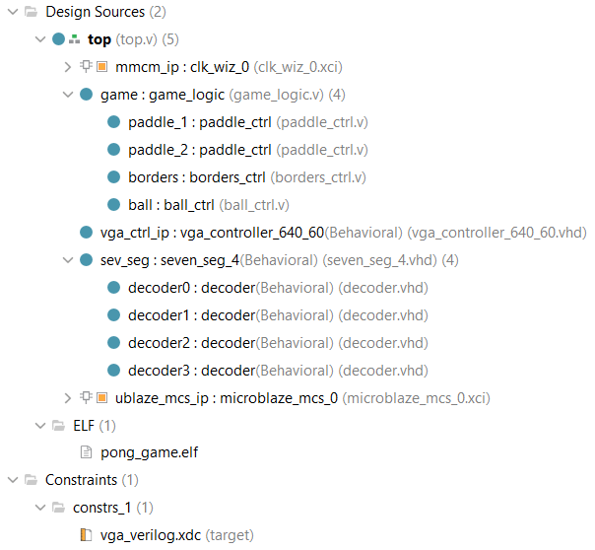
Hierarchy of Modules

Slide 5
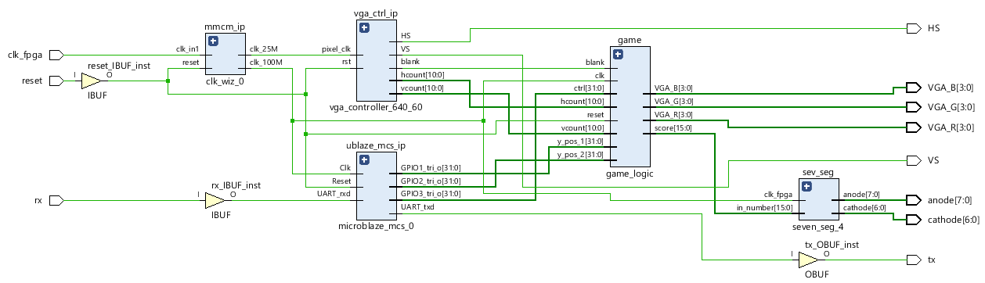
Block Diagram

Slide 6
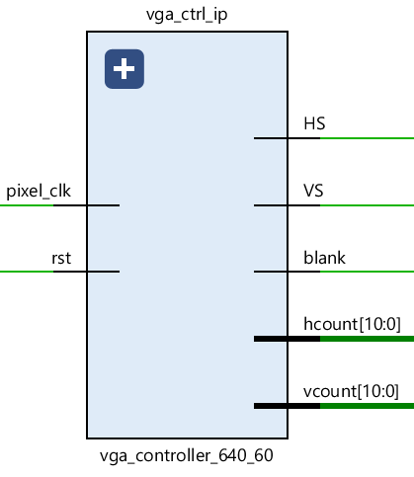
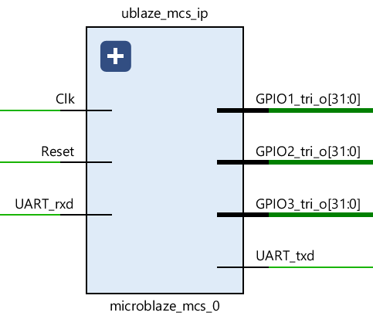
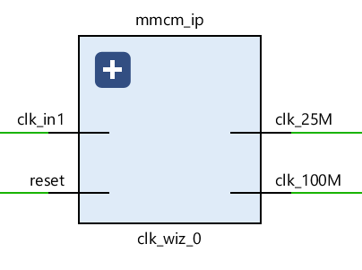
IP Cores
Notes:
Especially, tell about MicroBlaze (purpose)

Slide 7
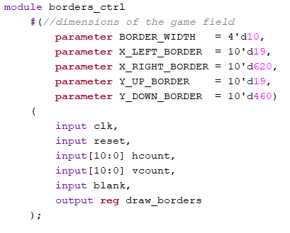
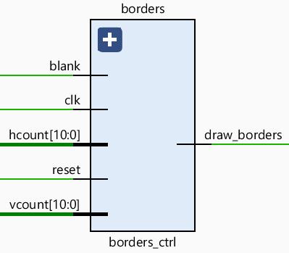
Custom Modules: borders_ctrl.v

Slide 8
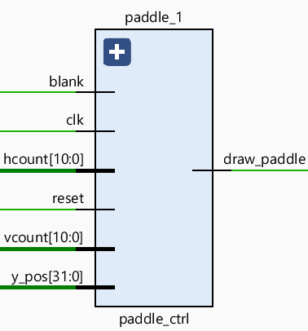
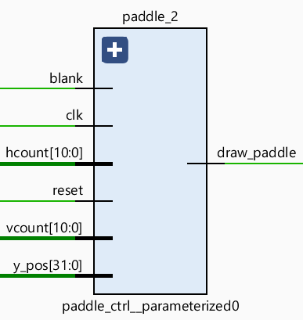
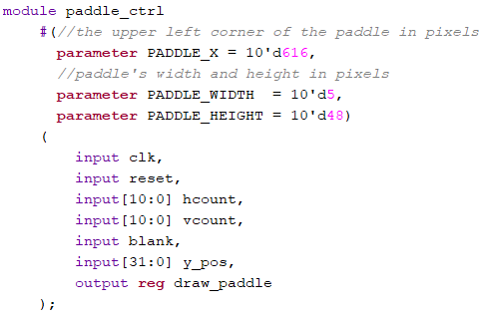
Custom Modules: paddle_ctrl.v

Slide 9
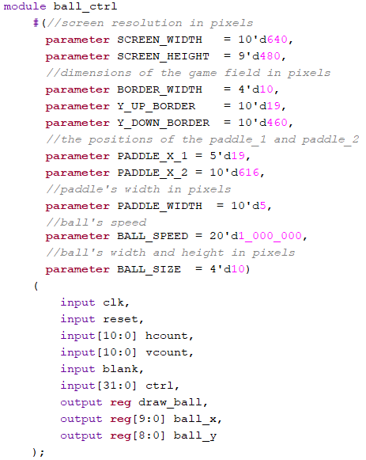
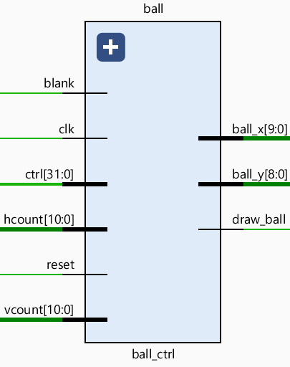
Custom Modules: ball_ctrl.v

Slide 10
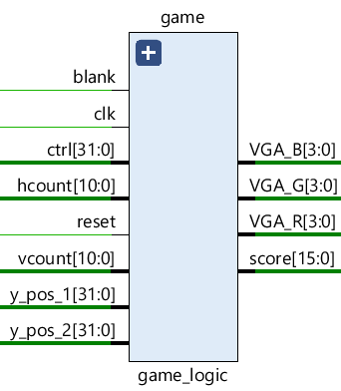
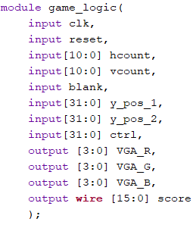
Custom Modules: game_logic.v

Slide 11
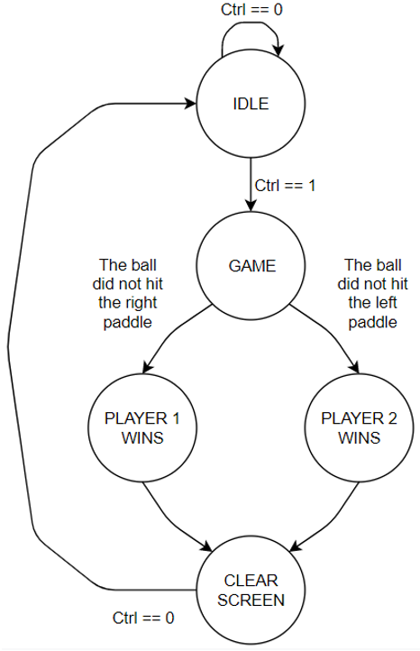
Custom Modules: game_logic.v

Slide 12
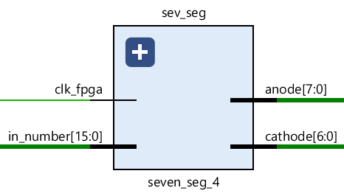
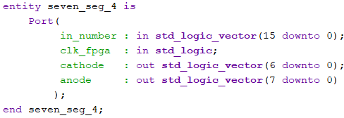
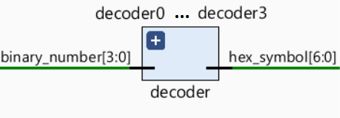
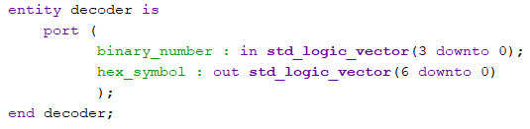
Custom Modules: seven_segment_4.vhd

Slide 13
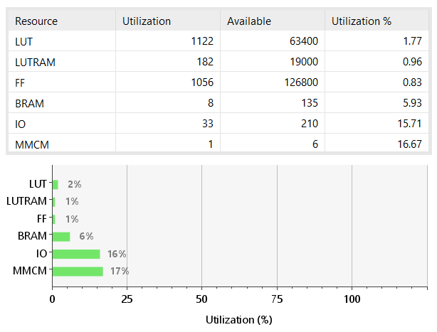
FPGA Resource Usage

Slide 14
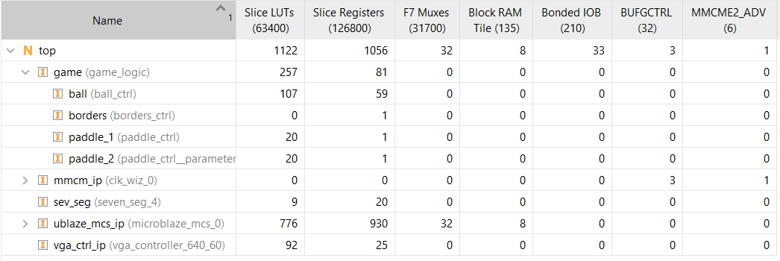
FPGA Resource Usage

Slide 15
Thank you!

